Slide 1
Amazon Review Analysis

Slide 2
Modules
Data Exploration & Visualization
Text Processing & Normalization
Vector Space Model & Feature Representation
Model Training
Modelling Text as a Sequence
High and Low Rating Modeling
Kaggle Competition

Slide 3
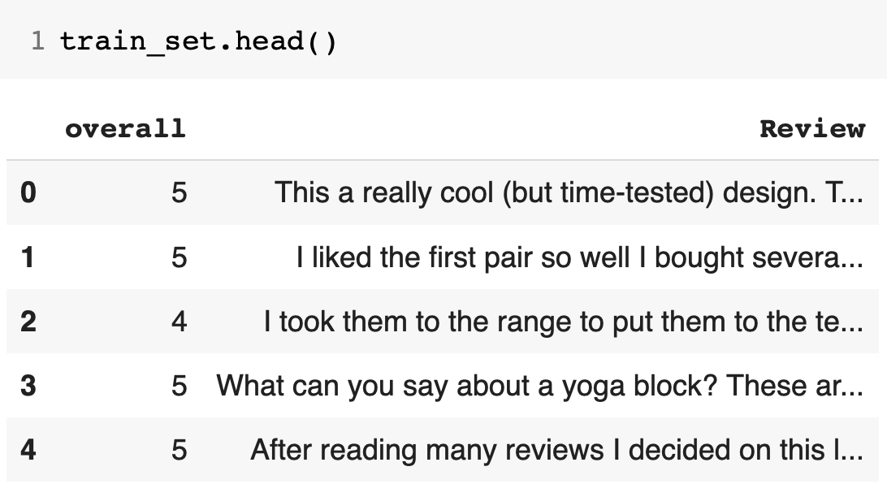
Data Visualization & Exploration
We Visualize, Explore and find
some relationship between
attributes from given
Dataset in the graphical
Representation.
Attributes :
Overall
Review

Slide 4
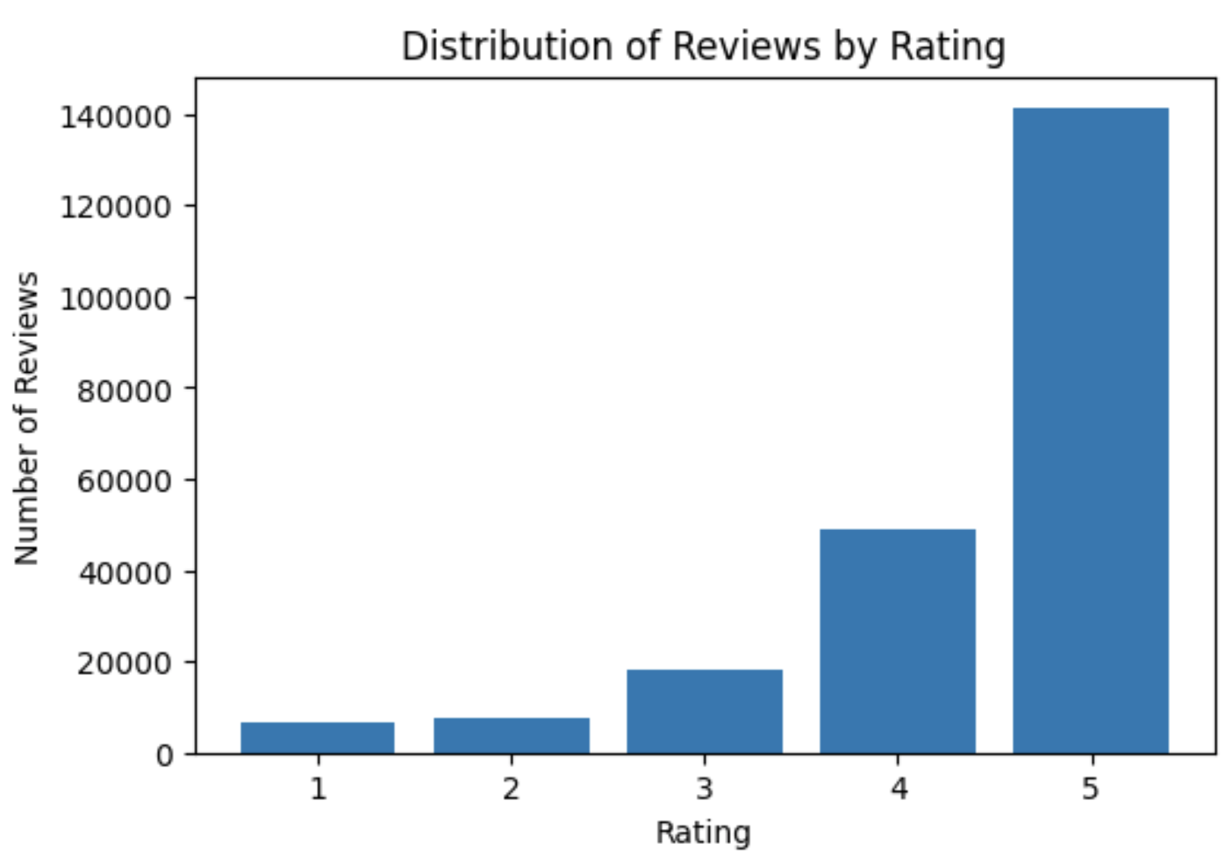
Data Visualization & Exploration

Slide 5
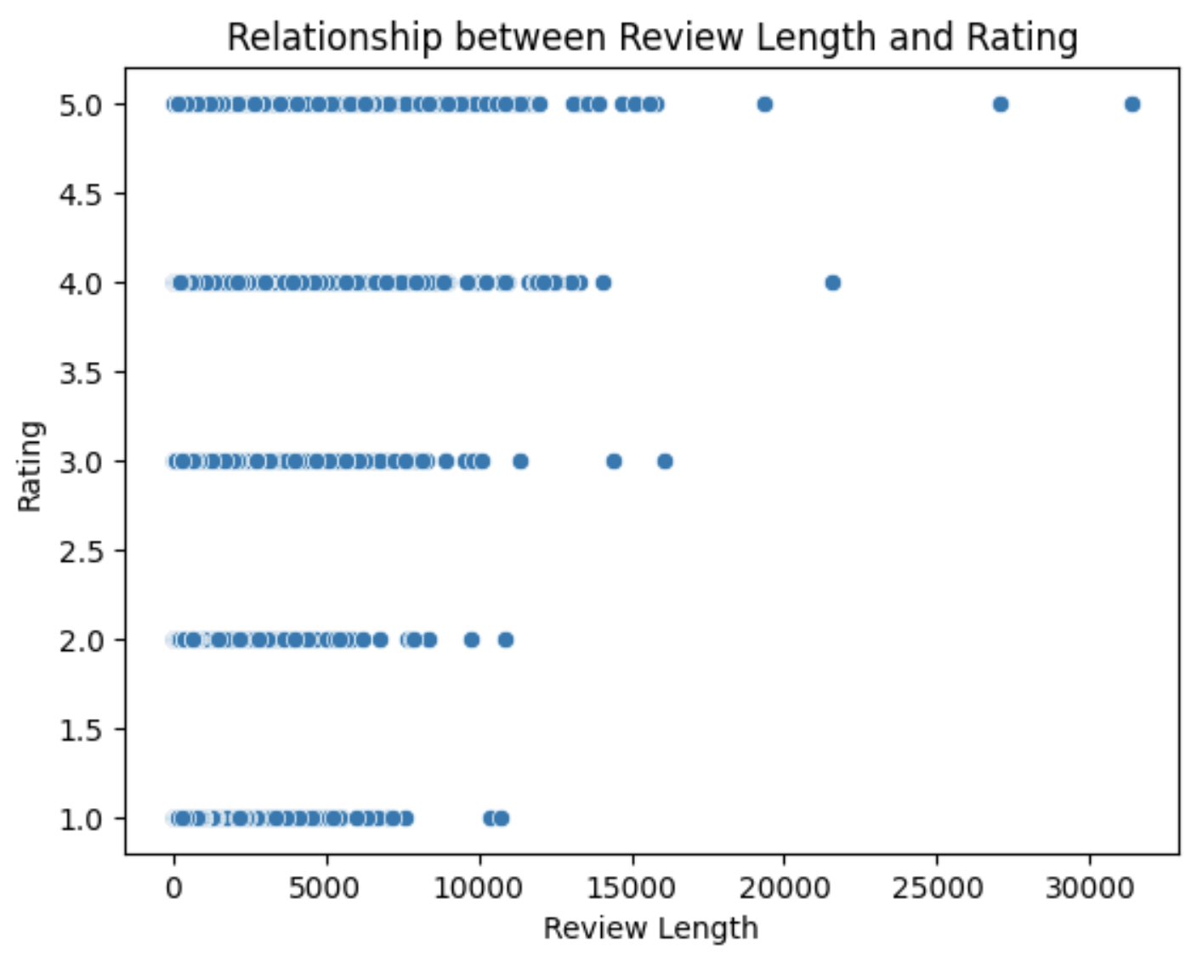
Data Visualization & Exploration

Slide 6
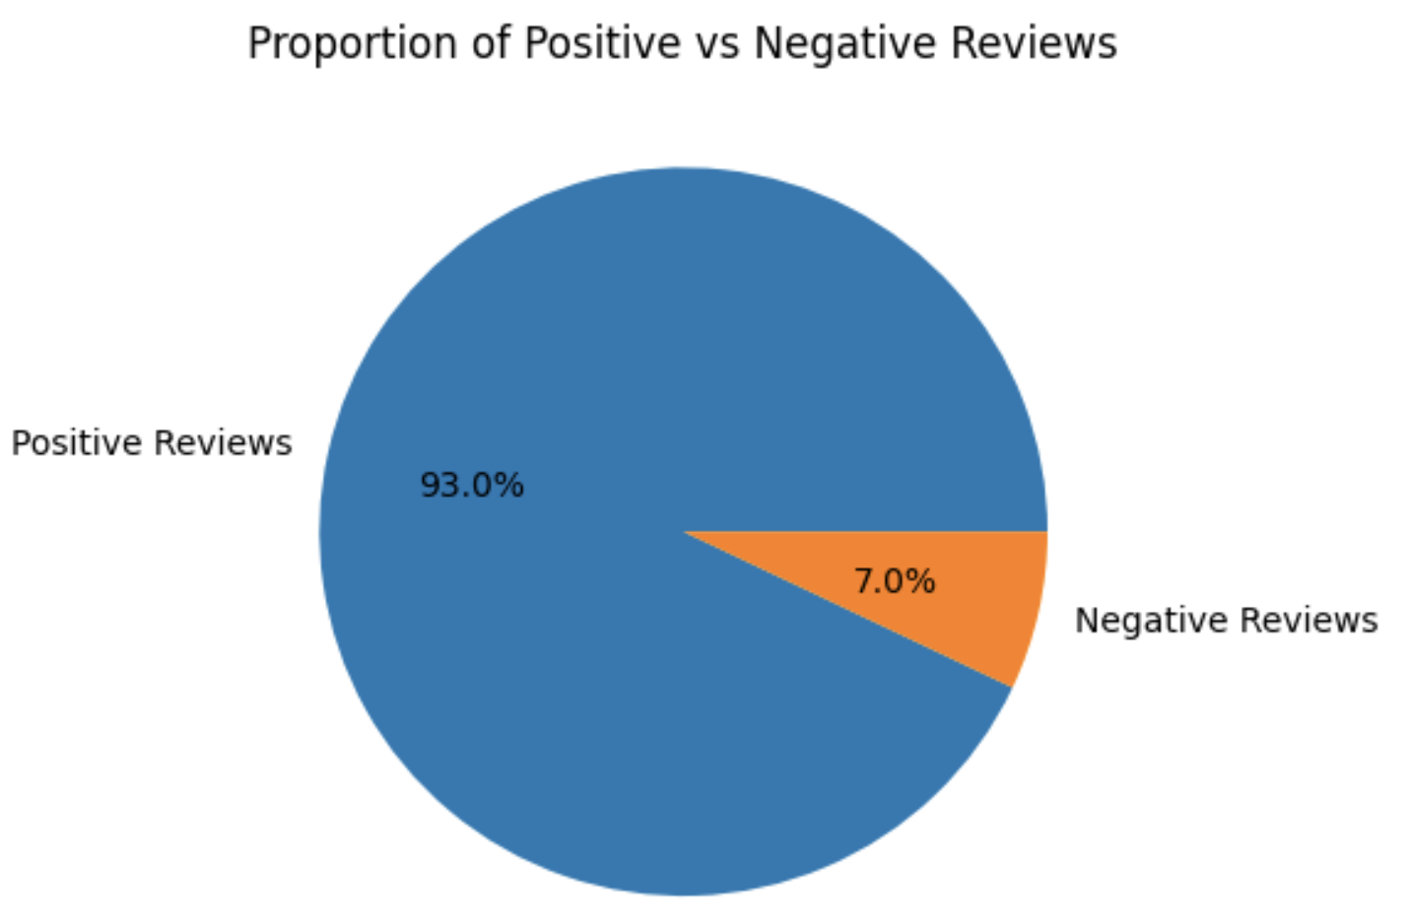
Data Visualization & Exploration

Slide 7
Text Processing & Normalization
The text processing (cleaning reviews) method includes two parameters:
The text we need to preprocess
The technique of preprocessing
The following steps are done in all the cases of preprocessing:
Drop duplicates if any before pre-processing
Remove html links
Remove accented characters
Convert to lower case
Remove digits
Fix contractions
Tokenization

Slide 8
Text Processing & Normalization
The following combinations of preprocessing techniques that the user might choose from:
1) Stemming + Punctuation Removal: 'stem_punc'
2) Stemming + Stop Words Removal: 'stem_stop'
3) Lemmatization + Punctuation Removal: 'lemma_punc'
4) Lemmatization + Stop Words Removal: 'lemma_stop'
5) Stemming + Punctuation Removal + Stop Words Removal : 'stem_punc_stop'
6) Lemmatization + Punctuation Removal + Stop Words Removal : 'lemma_punc_stop'

Slide 9
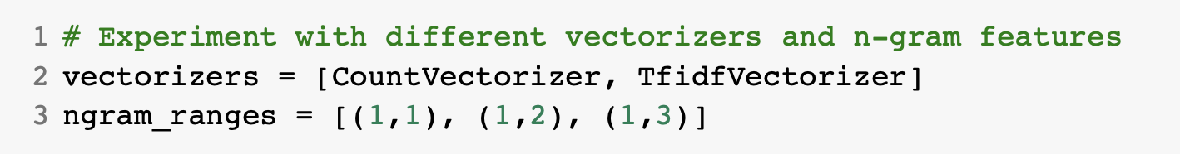
Vector space Model and feature representation
A nested loops on the following vectorizers and ngram ranges were done on some of the ML models in order to compare the scores of the models and choose the best vectorizer and ngram range
Results will be shown later after applying the models…

Slide 10
Model Training
The training dataset was split 70% training, 15% validation, and 15% testing.
The following models were trained:
Multinomial NB
Bernoulli NB
Random Forest
Decision Trees
GridSearch was used for hyperparameter tuning

Slide 11
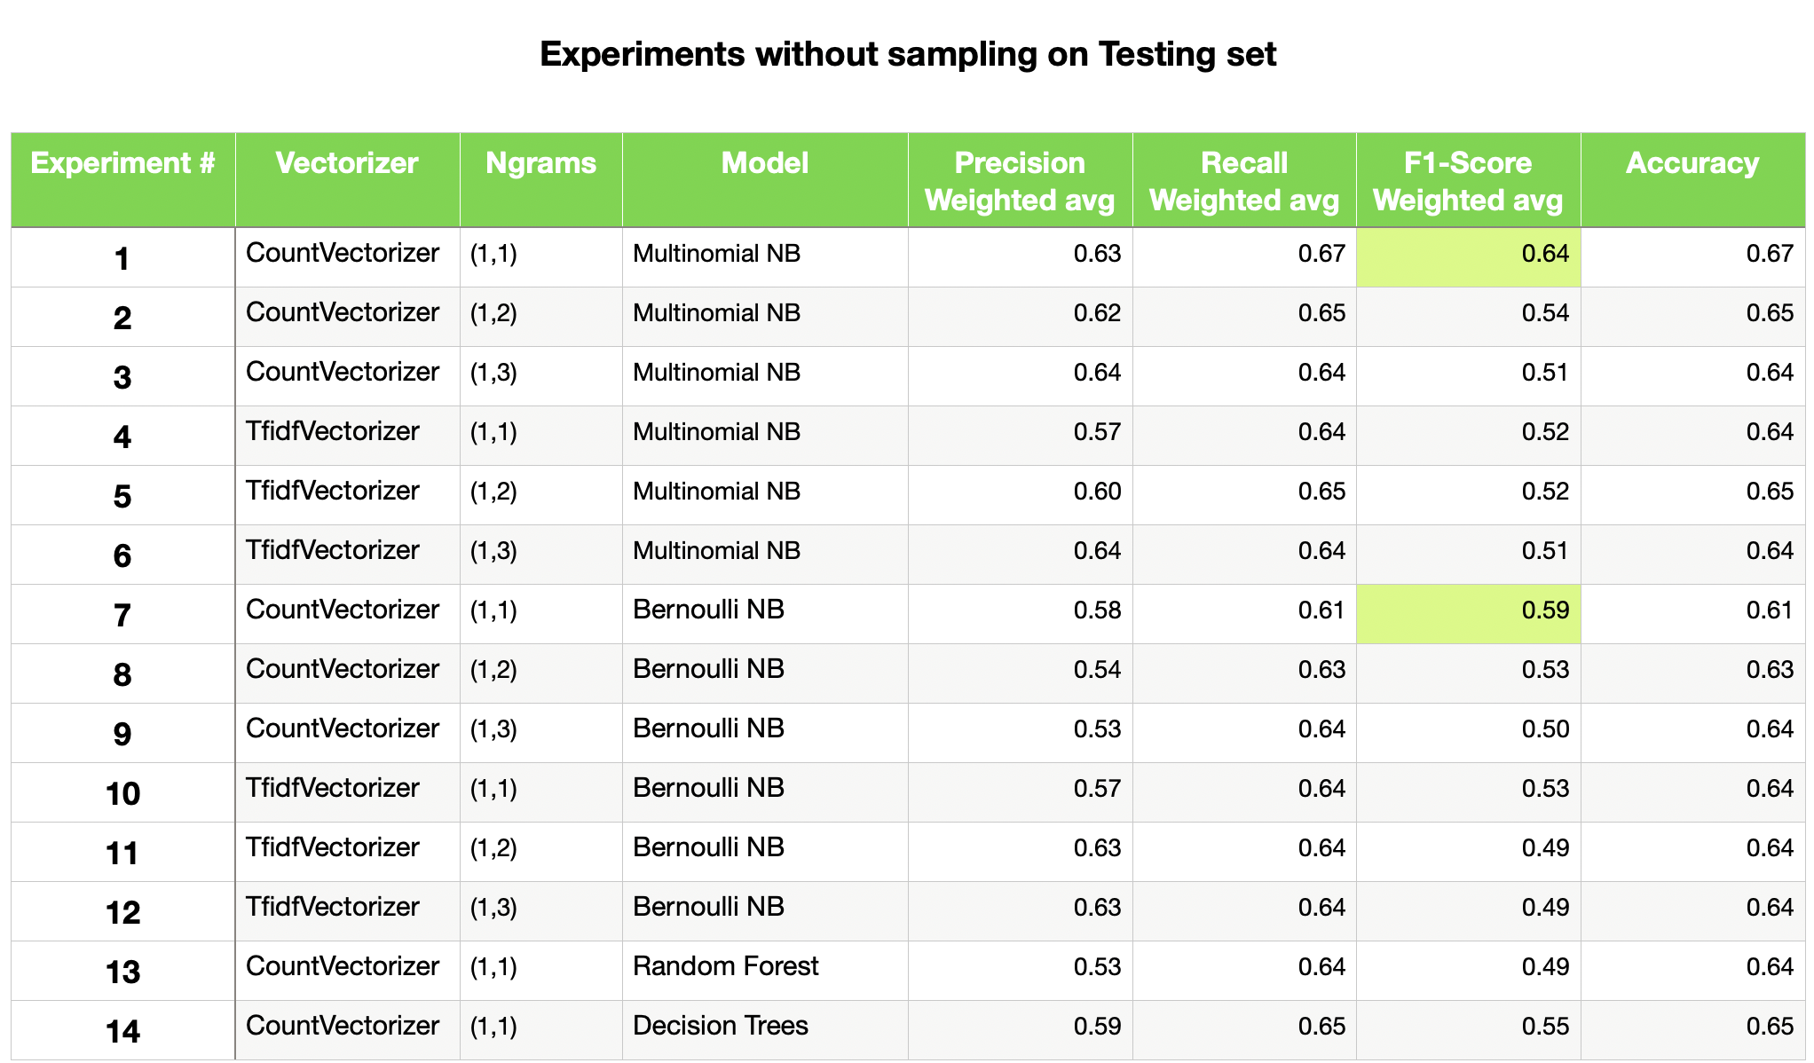
Notes:
We can see that using countvectorizer and unigram yields the best results

Slide 12
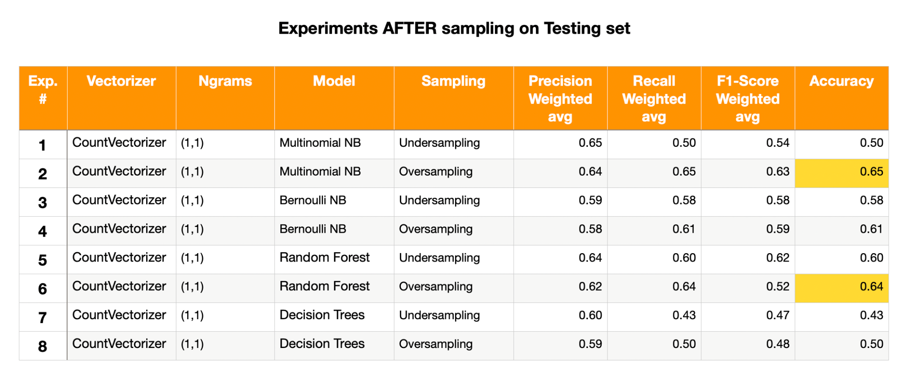

Slide 13
Modelling Text As A Sequence
Sequential model with Word Embeddings:
Bag Of Words has the disadvantage of losing semantic information present in word ordering
Word Embeddings – best way to retain semantics & represent text in a dense way
TF-IDF — Term Frequency-Inverse Document Frequency Statistical method to capture the relevance of words w.r.t the corpus of text. It does not capture semantic word associations. Better for information retrieval and keyword extraction in documents.
Word2Vec — Capturing Semantic Information Neural network-based CBOW and Skip-gram architectures, better at capturing semantic information. Useful in semantic analysis task.
GloVe — Global Vectors for Word Representation Matrix factorization based on global word-word co-occurrence.
It solves the local context limitations of Word2Vec, i.e it can derive relationships between words from a co-occurrence matrix.
Better at word analogy and named-entity recognition tasks.
We have downloaded and used 50 dimensional word embeddings for this experiment.
4. BERT — Bidirectional Encoder Representations from Transformers Transformer-based attention mechanism to capture high-quality contextual information. Language translation, question-answering system. Deployed in Google Search engine to understand search queries.

Slide 14
Models Trained (With Word Embedding)
Simple Sequential Neural Network
Sequential Convolutional Neural Network
Sequential Recurrent Neural Network (LSTM)
All the models are trained in small batches of few epochs and below were the results.
Model | Batch Size | Epochs | Training Accuracy | Validation Accuracy
Simple Neural Network | 128 | 10 | 65.80% | 60.08%
Sequential Convolutional Neural Network | 128 | 20 | 72.18% | 68.38%
Sequential Recurrent Neural Network (LSTM) | 128 | 10 | 63.46% | 63.26%

Slide 15
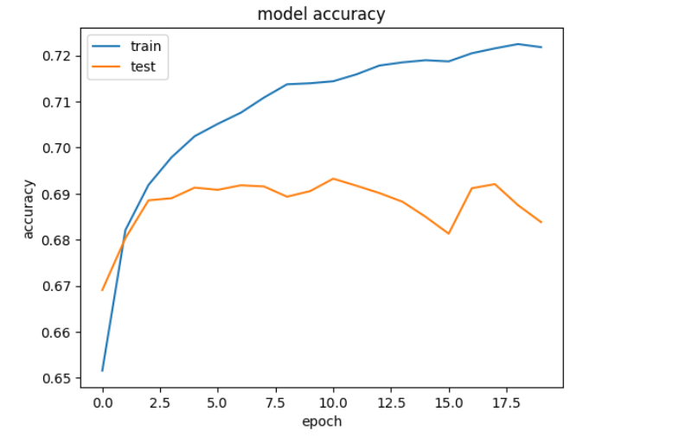
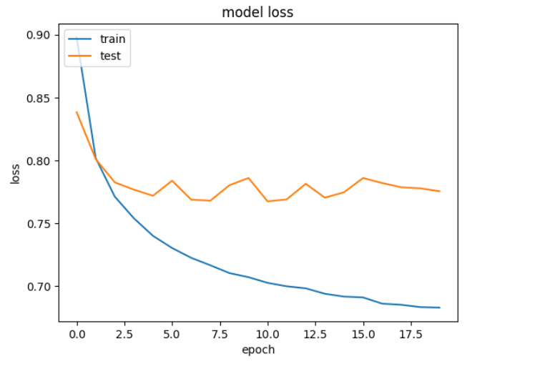

Slide 16
Topic Modelling
Topic modeling can be described as a method of finding a topic from the collection of documents that best represents the information in those documents.
We are using Gensim implementation of LDA(Latent Dirichlet allocation), a generative probabilistic model for collections of discrete text data and building a topic model.
Model built with 10 Topics to start with.
Coherence score is used as an evaluation metrics
0.42 (Before Tuning)
Topic Coherence measures score a single topic by measuring the degree of semantic similarity between high scoring words in the topic.
Hyperparameter Tuning (Topic Counts, Alpha: document-topic density & Beta: topic-word density)
Finally, using 'pyLDAvis’ for visualizing the topics and the word-topic distributions.

Slide 17
